Slide 1


SMART INDIA HACKATHON 2025
TITLE PAGE
Problem Statement ID – 25232
Problem Statement Title- Detection of Open Crust Mining Activity and 3D Visualization
Theme- Smart Automation
PS Category- Software
Team ID- 66629
Team Name- Planet Watch AI

Slide 2

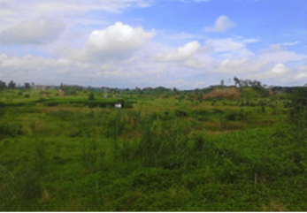

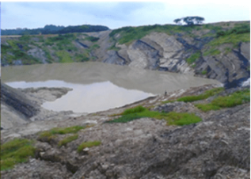


IDEA TITLE
Planet watch AI
Proposed Solution
AI-Driven Geo-Intelligence Platform – Our product, TerraWatch, applies Artificial Intelligence and satellite imaging to track and manage illegal open-crust mining in real time.
Satellite Image Analysis – Does the image collection from Sentinel, ISRO-Bhuvan, and other sources for land deformation, deforestation, and soil disturbance caused by mining.
Automated Risk Prediction – Applies analysis of vegetation loss, terrain slope, and distance to sensitive areas (rivers, villages, forests) to forecast future mining risks.
3D Interactive Mapping – Presents outputs as 3D maps and digital twins, enabling authorities to visually review and comprehend impacted areas with easily.
Real-Time Alerts & Reports – Provides real-time alerts, summary dashboards, and automatically generated PDF reports for authorities to act quickly.
User-Friendly Dashboard – Filtered for district officials and environmental officers with easy navigation and multi-language support for greater accessibility.
Outcome- Speeds up environmental monitoring, makes it more transparent and accessible — AI + Data + Action for the preservation of our planet.
Before
Citizen-Gov Collabration
Community Safety Alerts
Uniqueness Of Solution
AI Calculates Deforestation
Reduces Manual Effort
After
Long-Term Monitoring
Protects Ecosystem
Satellite
AI Model
Detection
Prediction
3D visualization
Future Scope
Accuracy → ~95-98% (with Al model & satellite imagery)
Alert Time → 24-48 hours, not months
Coverage → Entire district/state with daily revisit
Nation wide Scaling
Mobile App
Alerts
Report

Slide 3
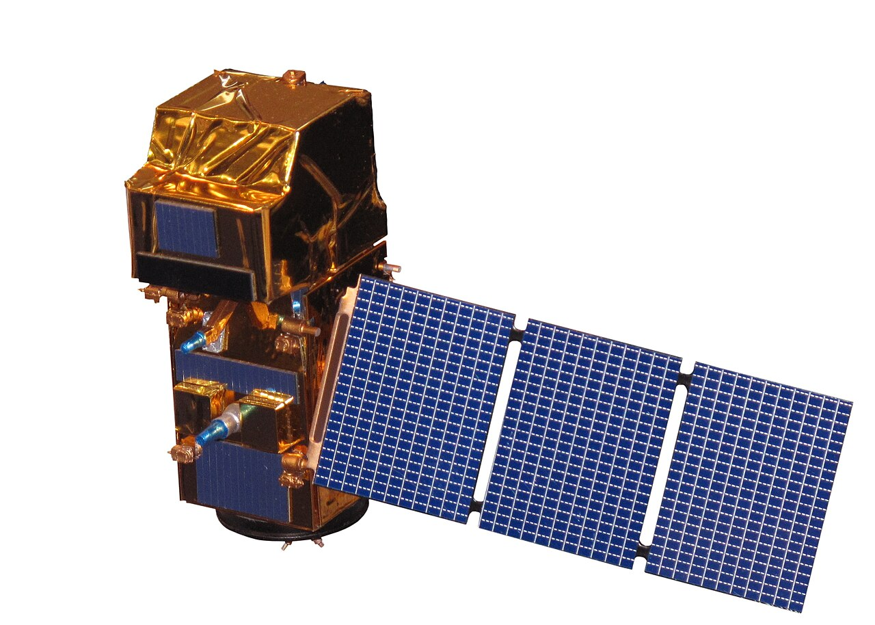
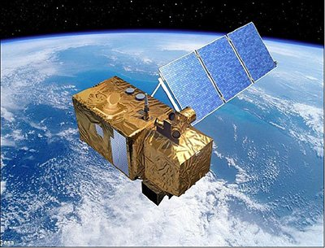
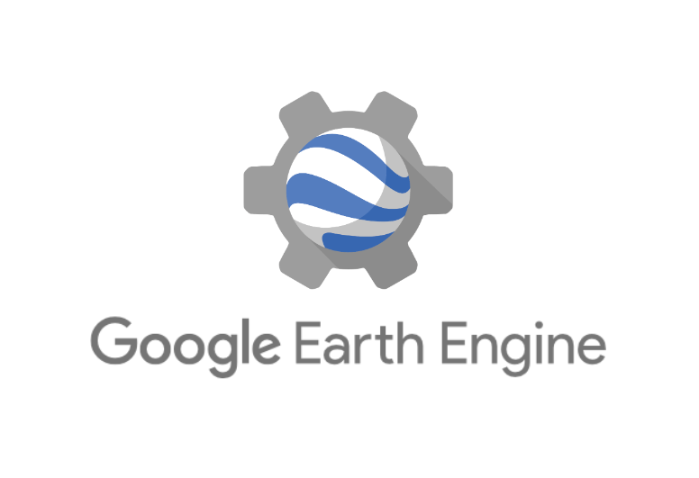
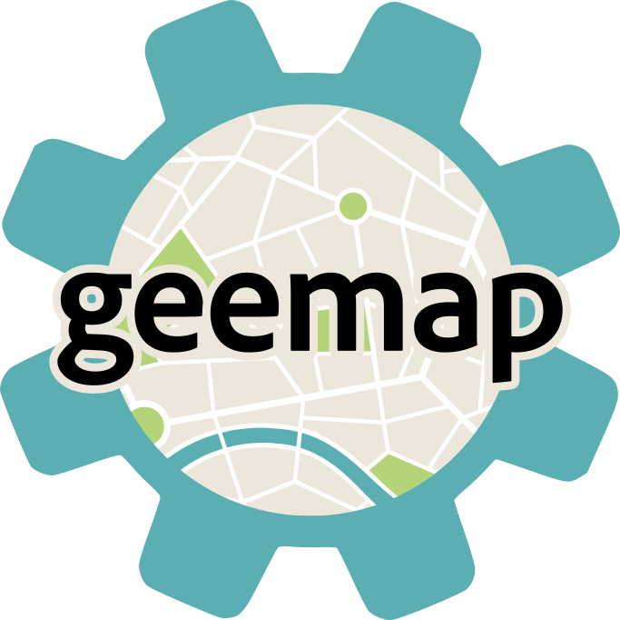
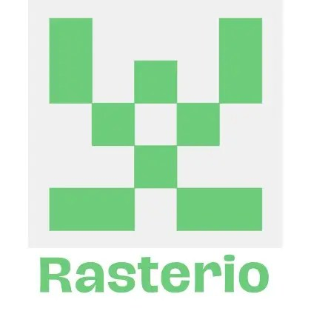





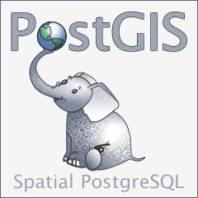

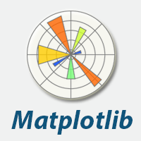
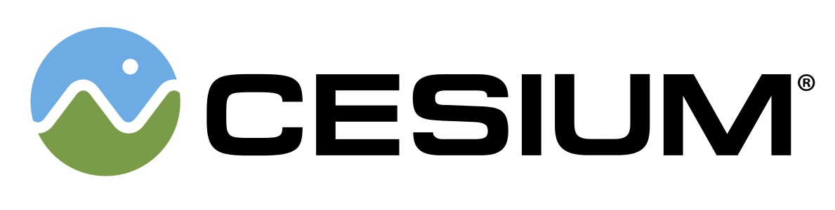

TECHNICAL APPROACH
Planet Watch AI
Input
Output
Satellite Data
Processing Image and Analysis
Detection of Mining Activity
3D visualization
Web Platform
Analysis Dashboard
GEE
Sentinal 2
Landsat 8/9
Python Library
Report Before & After
TensorFlow
PyTorch
Cesium = for 3D visualization
DEM (Digital Elevation Model)
GeoJson = To mark detect zone
Geemap
Rasterio
Open CV
NumPy
Numpy
Open CV
Matplotlib
Deep Learning Model
U-NET
Frontend: React + CesiumJS
Backend: Flask (Python) for ML processing
Database: PostgreSQL + PostGIS for spatial data
Cloud: AWS for hosting.
Map
Snapshots
Python
Matplotlib
Integration of AI+3D visualization
Automated GeoJSON overlay for real-time mapping
End to end web deployment(React+Flask+ML+PostGIS)
Free and open source

Slide 4
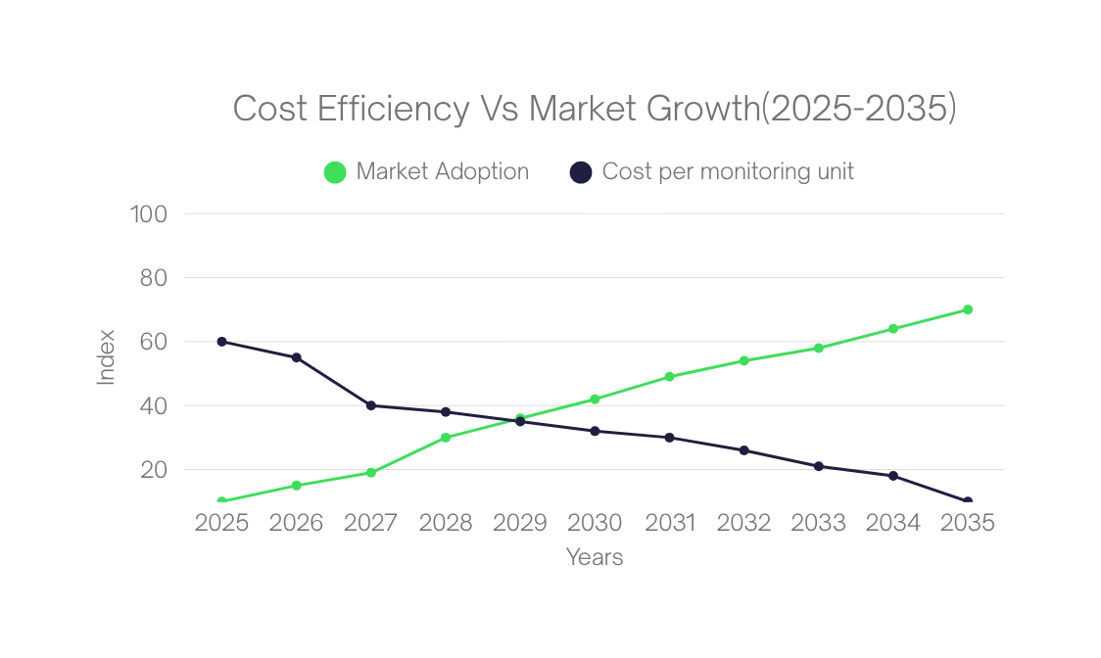
FEASIBILITY AND VIABILITY
Planet watch AI
Challenges | Solution
Low satellite image clarity due to whether or clouds | Combine SAR + optical data for all-weather and night-time visibility.
Misidentifying natural land as mining zones | Use AI with multi-spectral and elevation filters to improve precision.
Slow processing of large image datasets | Implement cloud-based AI pipelines for faster and scalable analysis.
Limited connectivity in remote mining areas | Use edge computing to analyze data offline and sync automatically later.
Financial Feasibility - Uses free satellite data for low-cost prototyping and affordable scalability. Cloud tools and government grants make it financially sustainable long term
Technical Feasibility - Integration of satellite (optical & SAR), UAV, and LiDAR enables accurate detection and 3D mapping.ML and GIS tools automate analysis using open APIs like Sentinel Hub and Google Earth Engine.
Viability
Reduces manual site inspections
Speeds up illegal mining detection
Enhances transparency and decision efficiency
Improves environmental monitoring accuracy
Feasibility
Operational Feasibility - Requires drone deployment, data processing setup, and trained staff for efficient monitoring .Easily integrates with existing GIS systems and local authorities for real-time updates.
Market Feasibility - Targets government, environmental, and mining sectors for sustainable monitoring. Supports Digital Earth & ESG goals, ensuring transparency and strong adoption potential.
Cost Efficient
Eco Impact
Scalability
Transparency

Slide 5

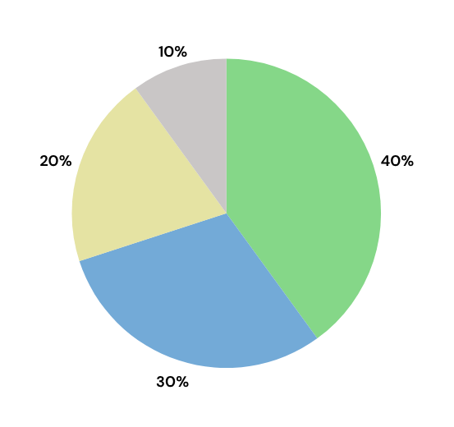
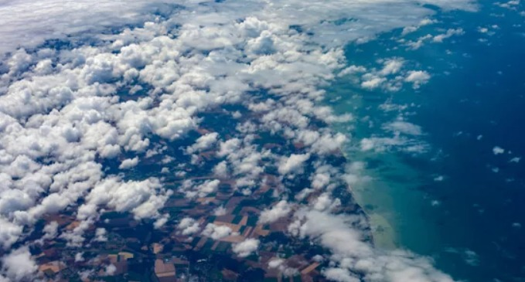
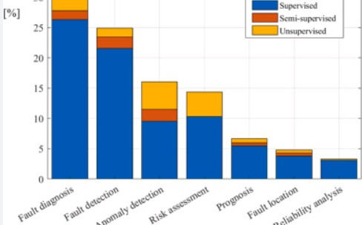

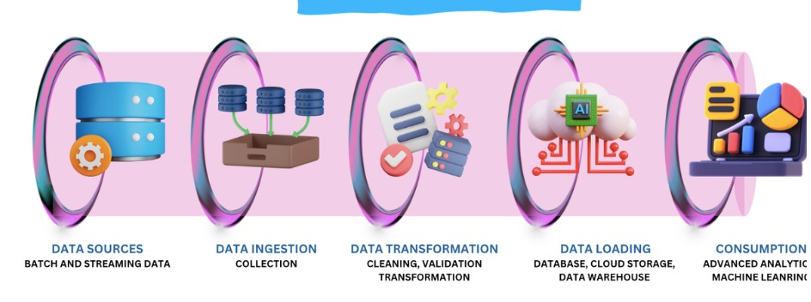
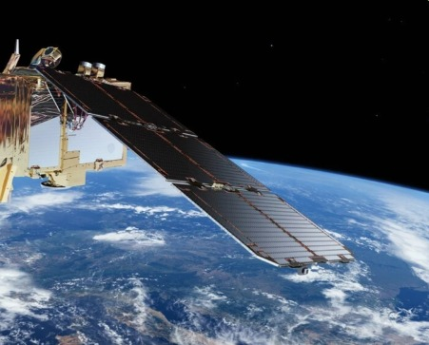
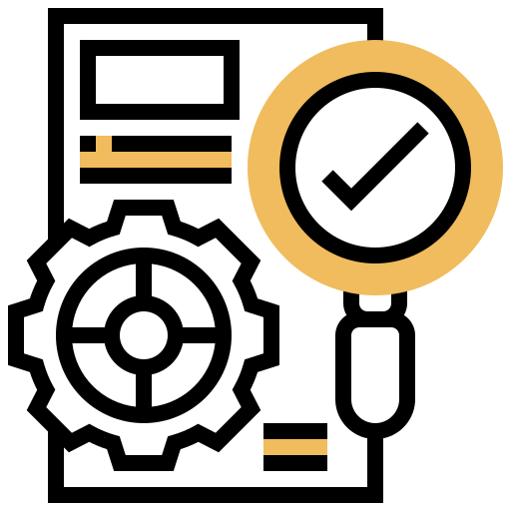
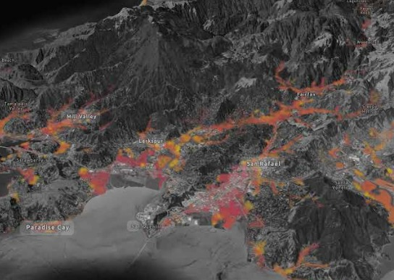



IMPACT AND BENEFITS
Planet Watch AI
THE IMPACT DONUT CHART
Early Detection: Satellite & AI quickly find Illegal mining, prevent environment harm
Transparency : 3D visuals and live
alerts give clear updates to both
government and citizens
Environmental Protection
Impact
Financial Loss Prevention
Governance & Transparency
Environment Protection: Reduce deforestation, soil loss & water pollution through continuous monitoring
Sustainable development: Encourages responsible mining and support a cleaner greener future
Time & Resource Savings
USP
Benefits
We overcome cloudy weather by Using SAR (Synthetic Aperture Radar) imagery that captures clear visuals even through clouds and darkness. | We enhance reliability with an AI confidence meter that transparently displays detection accuracy levels.
We handle massive data loads through cloud-based AI pipelines that ensure fast and scalable processing. | We reduce costs by leveraging open-source satellite APIs like Sentinel Hub and Google Earth Engine.
We address low-network challenges using edge computing, allowing offline analysis and automatic data syncing. | We empower sustainability by building 3D visualizations and Green Score dashboards that promote eco-friendly monitoring
Saves time and cost
No need for manual inspection
Give accurate result : AI improve with AI every scan
Easy to use : Simple dashboard and 3D Maps
Support legal action
Provides proof for authorities

Slide 6
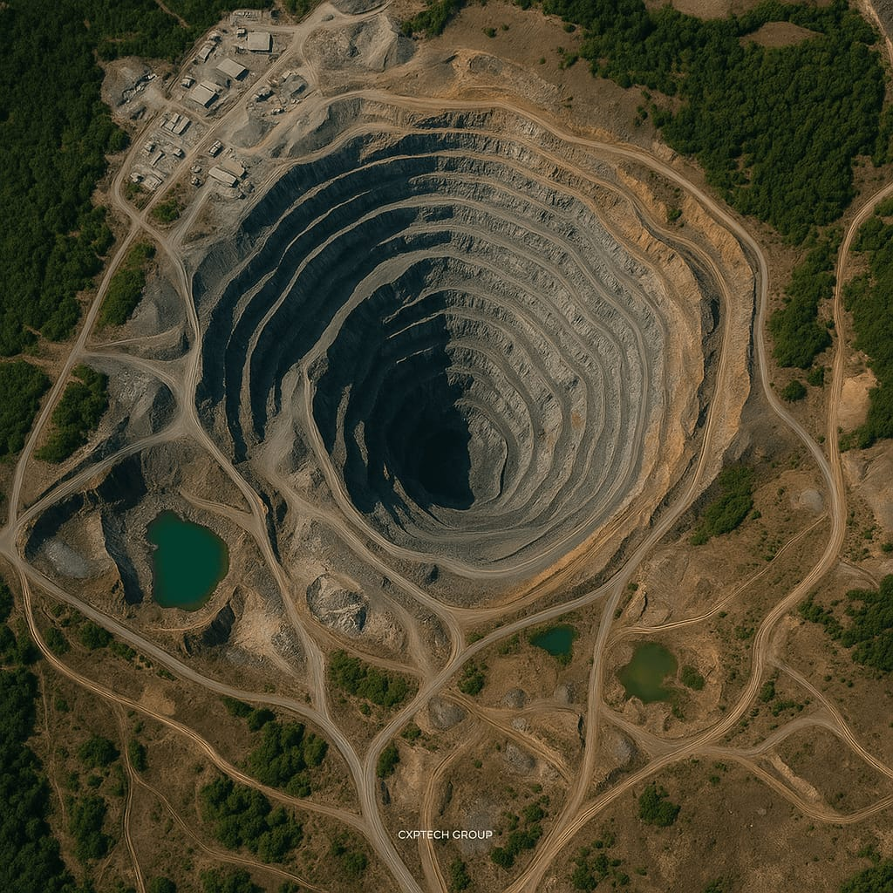
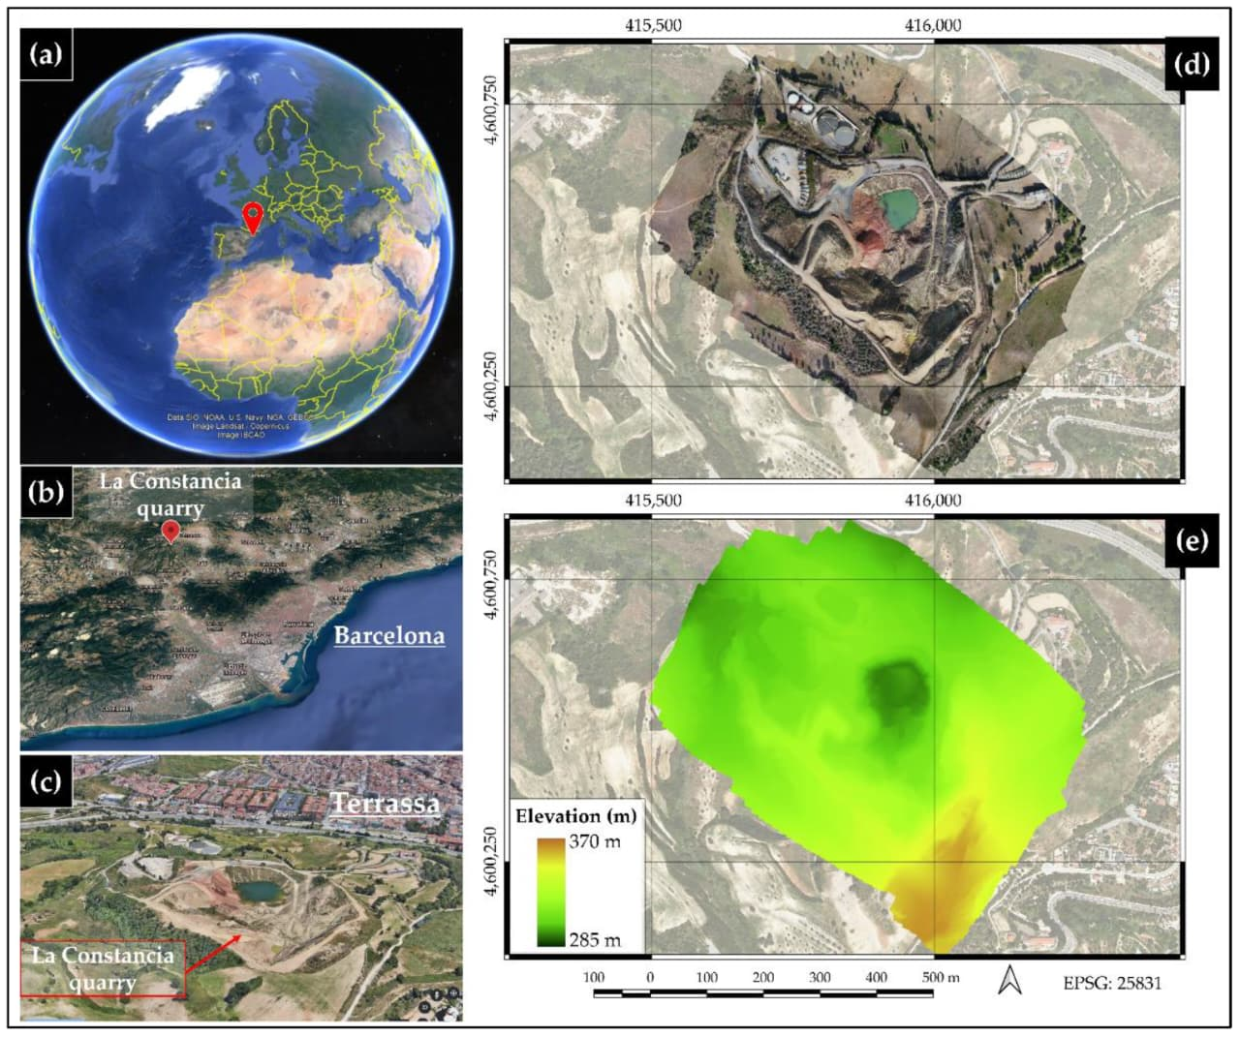
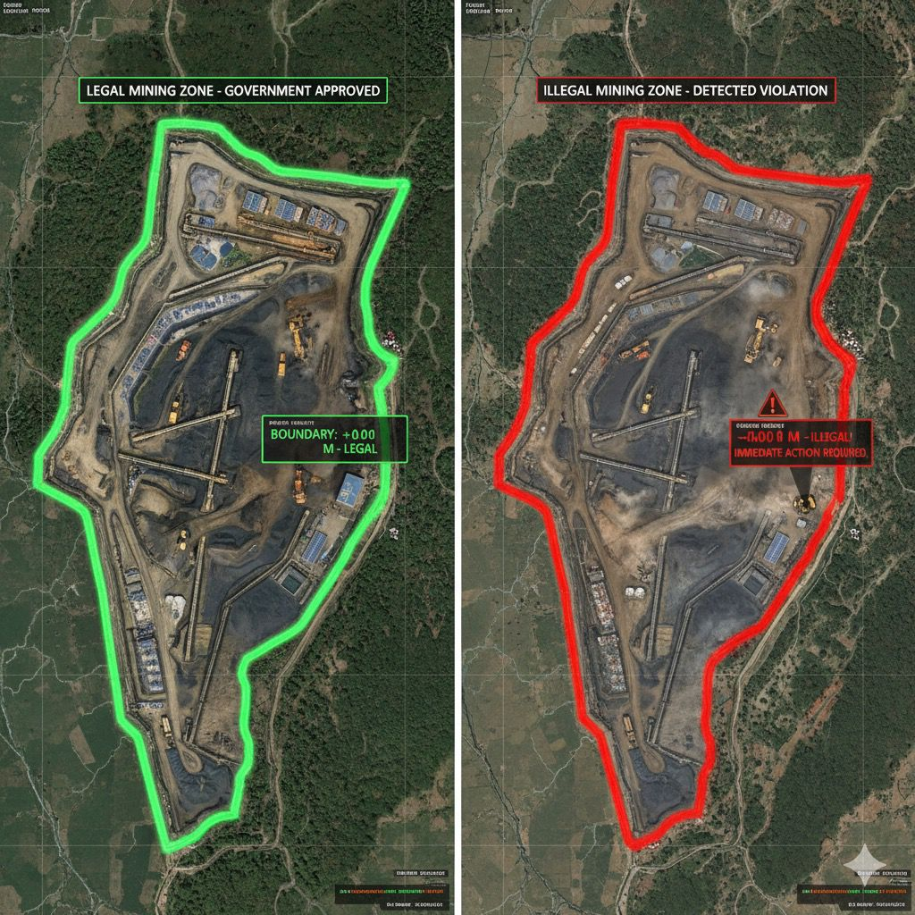
RESEARCH AND REFERENCES
Planet Watch AI
Project Prototype
https://sarveshgajakosh23-d.github.io/PLANET-WATCH---AI/
“Monitoring Mining Activities Using Sentinel-1A InSAR Coherence,” Remote Sensing (MDPI, 2021).
🔗 https://www.mdpi.com/2072-4292/13/21/4485
“Mining and Tailings Dam Detection Using Deep Learning,”
🔗 https://www.mdpi.com/1424-8220/20/23/6936
“Remote Sensing for Monitoring Mine Lands and Recovery Efforts.”
🔗 https://pubs.usgs.gov/publication/cir1525/full
“Global Mining Footprint Mapped from High-Resolution Satellite Imagery.”
🔗 https://www.nature.com/articles/s43247-023-00805-6
Google Earth Engine Dataset Catalog.
🔗https://developers.google.com/earth-engine/datasets

